Slide 1
OpenMP

Slide 2
Introduction
The OpenMP Application Programming Interface (API) was developed to enable portable shared memory parallel programming
The API is designed to permit an incremental approach to parallelizing an existing code, in which portions of a program are parallelized, possibly in successive steps
Contrast to the all-or-nothing conversion of an entire program in a single step that is typically required by other parallel programming paradigms

Slide 3
The Idea of OpenMP
A thread is a runtime entity that is able to independently execute a stream of instructions
The operating system creates a process to execute a program
It will allocate some resources to that process, including pages of memory and registers for holding values of objects
If multiple threads collaborate to execute a program, they will share the resources, including the address space, of the corresponding process
The individual threads need just a few resources of their own:
A program counter and an area in memory to save variables that are specific to it (including registers and a stack)

Slide 4
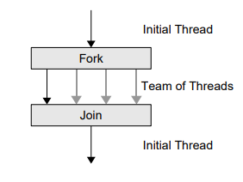
The Idea of OpenMP
Multiple threads may be executed on a single processor or core via context switches;
They may be interleaved via simultaneous multithreading
Threads running simultaneously on multiple processors or cores may work concurrently to execute a parallel program
It supports the so-called fork-join programming model

Slide 5
The Idea of OpenMP
The program starts as a single thread of execution, just like a sequential program
The thread that executes this code is referred to as the initial thread
Whenever an OpenMP parallel construct is encountered by a thread while it is executing the program, it creates a team of threads (this is the fork)
It becomes the master of the team, and collaborates with the other members of the team to execute the code dynamically enclosed by the construct
At the end of the construct, only the original thread, or master of the team, continues; all others terminate (this is the join)
Each portion of code enclosed by a parallel construct is called a parallel region

Slide 6
The Feature Set
The OpenMP API comprises a set of compiler directives, runtime library routines, and environment variables to specify shared-memory parallelism
Directive: A statement written in the source code of a program that lets the programmer instruct the compiler to perform a specific operation within the compilation phase.
Environmental variables define the characteristics of a specific environment
Library routines (API) that helps to do some task
An OpenMP directive is a specially formatted comment or pragma that generally applies to the executable code immediately following it in the program
A directive or OpenMP routine generally affects only those threads that encounter it
Many of the directives are applied to a structured block of code
A sequence of executable statements with a single entry at the top and a single exit at the bottom

Slide 7
The Feature Set
OpenMP provides means for the user to:
Create teams of threads for parallel execution
Specify how to share work among the members of a team
Declare both shared and private variables
Synchronize threads and enable them to perform certain operations exclusively (i.e., without interference by other threads)

Slide 8
Creating Teams of Threads
A team of threads is created to execute the code in a parallel region of an OpenMP program
To accomplish this, the programmer simply specifies the parallel region by inserting a parallel directive immediately before the code that is to be executed in parallel to mark its start
At the end of a parallel region is an implicit barrier synchronization
This means that no thread can progress until all other threads in the team have reached that point in the program
If a team of threads executing a parallel region encounters another parallel directive, each thread in the current team creates a new team of threads and becomes its master
Nesting enables the realization of multilevel parallel programs

Slide 9
Sharing Work among Threads
If the programmer does not specify how the work in a parallel region is to be shared among the executing threads, they will each redundantly execute all of the code
This approach does not speed up the program
The OpenMP work-sharing directives are provided for the programmer to state how the computation in a structured block of code is to be distributed among the threads
Unless explicitly overridden by the programmer, an implicit barrier synchronization also exists at the end of a work-sharing construct

Slide 10
Sharing Work among Threads
Probably the most common work-sharing approach is to distribute the work for (C/C++) loop among the threads in a team
To accomplish this, the programmer inserts the appropriate directive immediately before each loop within a parallel region that is to be shared among threads
Work-sharing directives cannot be applied to all kinds of loops that occur in C/C++ code
Many programs, especially scientific applications, spend a large fraction of their time in loops performing calculations on array elements and so this strategy is widely applicable and often very effective

Slide 11
Sharing Work among Threads
All OpenMP strategies for sharing the work in loops assign one or more disjoint sets of iterations to each thread
The programmer may specify the method used to partition the iteration set
The most straightforward strategy assigns one contiguous chunk of iterations to each thread
More complicated strategies include dynamically computing the next chunk of iterations for a thread
If the programmer does not provide a strategy, then an implementation-defined default will be used.

Slide 12
Sharing Work among Threads
It must be possible to determine the number of iterations in the loop upon entry, and this number may not change while the loop is executing
While construct, for example, may not satisfy this condition
Furthermore, a loop is suitable for sharing among threads only if its iterations are independent
By this, we mean that the order in which the iterations are performed has no bearing on the outcome

Slide 13
Sharing Work among Threads
If giving distinct pieces of work to the individual threads
This approach is suitable when independent computations are to be performed and the order in which they are carried out is irrelevant
It is straightforward to specify this by using the corresponding OpenMP directive
The programmer must ensure that the computations can truly be executed in parallel
It is also possible to specify that just one thread should execute a block of code in a parallel region

Slide 14
The OpenMP Memory Model
OpenMP is based on the shared-memory model; hence, by default, data is shared among the threads and is visible to all of them
Sometimes, however, one needs variables that have thread-specific values
When each thread has its own copy of a variable, so that it may potentially have a different value for each of them, we say that the variable is private
For example, when a team of threads executes a parallel loop, each thread needs its own value of the iteration variable.
The use of private variables can be beneficial in several ways:
They can reduce the frequency of updates to shared memory
Thus, they may help avoid hot spots, or competition for access to certain memory locations, which can be expensive if large numbers of threads are involved.

Slide 15
The OpenMP Memory Model
Threads need a place to store their private data at run time
For this, each thread has its own special region in memory known as the thread stack
A flush operation makes sure that the thread calling it has the same values for shared data objects as does main memory
Hence, new values of any shared objects updated by that thread are written back to shared memory, and the thread gets any new values produced by other threads for the shared data it reads

Slide 16
OpenMP Code Structure
#include <stdlib.h>
#include<stdio.h>
#include "omp.h“
int main()
{
#pragma omp parallel
{
int ID = omp_get_thread_num();
printf("Hello (%d)\n", ID);
printf(" world (%d)\n", ID);
}
}

Slide 17
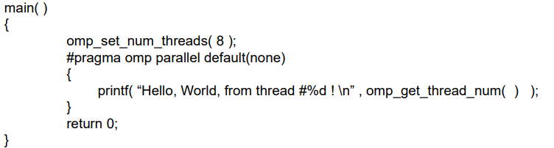
A sample OpenMP program

Slide 18
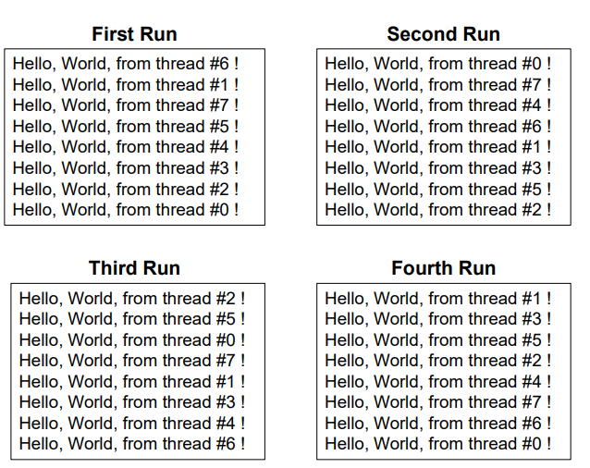
A sample OpenMP program

Slide 19
Thread Synchronization
Why synchronization?:
Synchronizing, or coordinating the actions of, threads is sometimes necessary in order to ensure the proper ordering of their accesses to shared data and to prevent data corruption
By default, OpenMP gets threads to wait at the end of a worksharing construct or parallel region until all threads in the team executing it have finished their portion of the work. Only then can they proceed. This is known as a barrier
Sometimes a programmer may need to ensure that only one thread at a time works on a piece of code
Synchronization points are those places in the code where synchronization has been specified, either explicitly or implicitly

Slide 20
OpenMP Programming Styles
OpenMP encourages structured parallel programming and relies heavily on distributing the work in loops among threads. But sometimes the amount of loop-level parallelism in an application is limited
One can also write OpenMP programs that do not rely on work-sharing directives but rather assign work explicitly to different threads using their thread numbers.
This approach can lead to highly efficient code
However, the programmer must then insert synchronization manually to ensure that accesses to shared data are correctly controlled
Those approaches that require manual assignment of work to threads and that need explicit synchronization are often called “low-level programming”

Slide 21
What is OpenMP?
Open specifications for Multi Processing
An Application Program Interface (API) that is used to explicitly direct multi-threaded, shared memory parallelism
API components:
Compiler directives
Runtime library routines
Environment variables
Portability
API is specified for C/C++ and Fortran
Implementations on almost all platforms including Unix/Linux and Windows
Standardization
Jointly defined and endorsed by major computer hardware and software vendors
Possibility to become ANSI standard

Slide 22
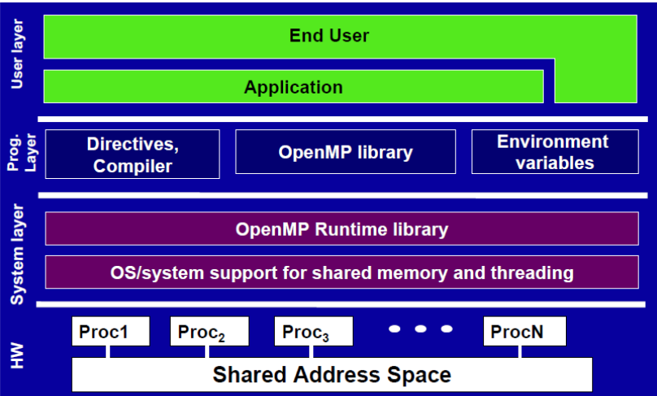

Slide 23
Threads & Process
A process is an instance of a computer program that is being executed. It contains the program code and its current activity.
A thread of execution is the smallest unit of processing that can be scheduled by an operating system
Differences between threads and processes:
A thread is contained inside a process. Multiple threads can exist within the same process and share resources such as memory. The threads of a process share the latter’s instructions (code) and its context (values that its variables reference at any given moment)
Different processes do not share these resources.

Slide 24
Threads & Process
A process contains all the information needed to execute the program
Process ID
Program code
Data on run time stack
Global data
Data on heap
Each process has its own address space
In multitasking, processes are given time slices in a round robin fashion
If computer resources are assigned to another process, the status of the present process has to be saved, in order that the execution of the suspended process can be resumed at a later time.

Slide 25
Threads & Process
Each process consists of multiple independent instruction streams (or threads) that are assigned computer resources by some scheduling procedure
Threads of a process share the address space of this process
Global variables and all dynamically allocated data objects are accessible by all threads of a process
Each thread has its own run-time stack, register, program counter
Threads can communicate by reading/writing variables in the common address space

Slide 26
OpenMP Programming Model
Shared memory, thread-based parallelism
OpenMP is based on the existence of multiple threads in the shared memory programming paradigm
A shared memory process consists of multiple threads
Explicit Parallelism
Programmer has full control over parallelization. OpenMP is not an automatic parallel programming model
Compiler directive based
Most OpenMP parallelism is specified through the use of compiler directives which are embedded in the source code

Slide 27
What OpenMP Isn’t
OpenMP doesn’t check for data dependencies, data conflicts, deadlocks, or race conditions. You are responsible for avoiding those yourself
OpenMP doesn’t check for non-conforming code sequences
OpenMP doesn’t guarantee identical behavior across vendors or hardware, or even between multiple runs on the same vendor’s hardware
OpenMP doesn’t guarantee the order in which threads execute, just that they do execute
OpenMP is not overhead-free
OpenMP does not prevent you from writing code that triggers cache performance problems

Slide 28
OpenMP: parallel regions
A parallel region within a program is specified as
#pragma omp parallel [clause [[,] clause] …]
Structured-block
A team of threads is formed
Thread that encountered the omp parallel directive becomes the master thread within this team
The structured-block is executed by every thread in the team.
At the end, there is an implicit barrier
Only after all threads have finished, the threads created by this directive are terminated and only the master resumes execution
A parallel region might be refined by a list of clause

Slide 29
Each thread in the team is assigned a unique thread number (also referred to as the “thread id”) to identify it.
They range from zero (for the master thread) up to one less than the number of threads within the team, and they can be accessed by the programmer.
Although the parallel region is executed by all threads in the team, each thread is allowed to follow a different path of execution.

Slide 30
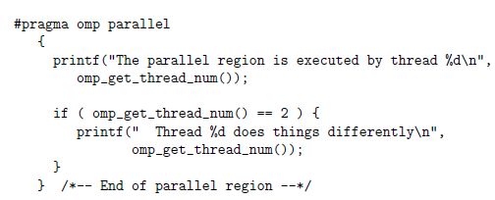

Each thread will execute all code in the parallel region, so that each thread will perform the first print statement.
However, only one thread will actually execute the second print statement (assuming there are at least three threads in the team), since we used the thread number to control its execution.
Output:

Slide 31
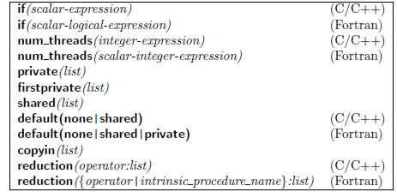
Clauses supported by the parallel construct

Slide 32
There are several restrictions on the parallel construct and its clauses:
A program that branches into or out of a parallel region is nonconforming.
In other words, if a program does so, then it is illegal, and the behavior is undefined.
A program must not depend on any ordering of the evaluations of the clauses of the parallel directive or on any side effects of the evaluations of the clauses.
At most one if clause can appear on the directive.
At most one num_threads clause can appear on the directive. The expression for the clause must evaluate to a positive integer value.
In C++ there is an additional constraint. A throw inside a parallel region must cause execution to resume within the same parallel region, and it must be caught by the same thread that threw the exception.

Slide 33
Active parallel region and an Inactive parallel region
A parallel region is active if it is executed by a team of threads consisting of more than one thread.
If it is executed by one thread only, it has been serialized and is considered to be inactive.
Example: - one can specify that a parallel region be conditionally executed, in order to be sure that it contains enough work for this to be worthwhile.
If the condition does not hold at run time, then the parallel region will be inactive.
#pragma omp parallel if (n > 5) default(none)
Here the parallel region is executed only if n is greater than 5.
A parallel region may also be inactive if it is nested within another parallel region and this feature is either disabled or not provided by the implementation

Slide 34
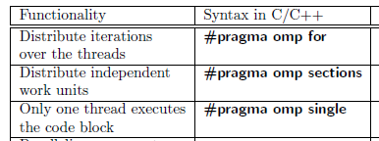
Sharing the Work among Threads in an OpenMP Program
C/C++ has three work-sharing constructs.
Many applications can be parallelized by using just a parallel region and one or more of these constructs, possibly with clauses
Work-sharing construct, along with its terminating construct where appropriate, specifies a region of code whose work is to be distributed among the executing threads; it also specifies the manner in which the work in the region is to be parceled out.
A work-sharing region must bind to an active parallel region in order to have an effect

Slide 35
Since work-sharing directives may occur in procedures that are invoked both from within a parallel region as well as outside of any parallel regions, they may be exploited during some calls and ignored during others
The two main rules regarding work-sharing constructs are as follows:
Each work-sharing region must be encountered by all threads in a team or by none at all.
The sequence of work-sharing regions and barrier regions encountered must be the same for every thread in a team.
A work-sharing construct does not launch new threads and does not have a barrier on entry. By default, threads wait at a barrier at the end of a work-sharing region until the last thread has completed its share of the work.

Slide 36

Loop Construct
The loop construct causes the iterations of the loop immediately following it to be executed in parallel.
At run time, the loop iterations are distributed across the threads. This is probably the most widely used of the work-sharing features.
In C and C++ programs, the use of this construct is limited to those kinds of loops where the number of iterations can be counted;
that is, the loop must have an integer counter variable whose value is incremented (or decremented) by a fixed amount at each iteration until some specified upper (or lower) bound is reached
Note the lack of curly braces.
These are implied with the construct.

Slide 37
The loop header must have the general form.
for (init-expr ; var relop b ; incr-expr)
where
init-expr stands for the initialization of the loop counter var via an integer expression
b is also an integer expression
relop is one of the following: <, <=, >, >=
The incr-expr is a statement that increments or decrements var by an integer amount using a standard operator (++, –, +=, -=). Alternatively, it may take a form such as var = var + incr.

Slide 38
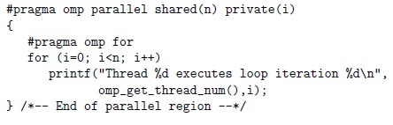
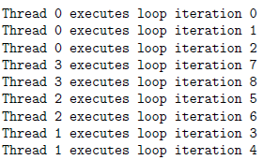
A parallel directive is used to define a parallel region and then share its work among threads via the for work sharing directive:
the #pragma omp for directive states that iterations of the loop following it will be distributed
omp get thread num(), is used obtain and print the number of the executing thread in each iteration
Clauses are added to the parallel construct that state which data in the region is shared and which is private.
Loop variable i is explicitly declared to be a private variable by the compiler, which means that each thread will have its own copy of i.
Unless the programmer takes special action its value is also undefined after the loop has finished
Output : The example is executed for n = 9 and uses four threads
Since the total number of iterations is 9 and four threads are used, one thread has to execute the additional iteration. In this case it turns out to be thread 0, the so-called master thread

Slide 39
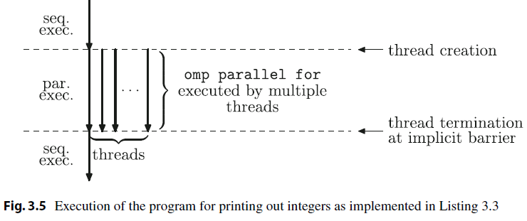

Slide 40
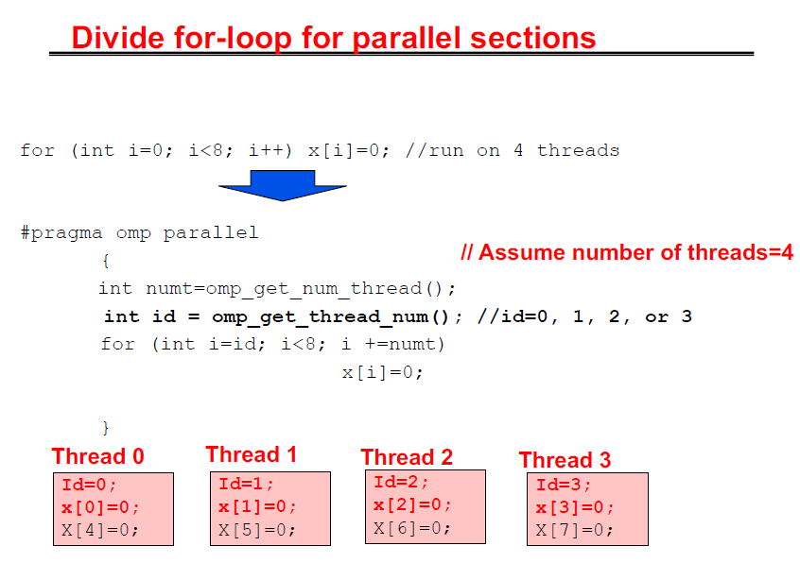

Slide 41
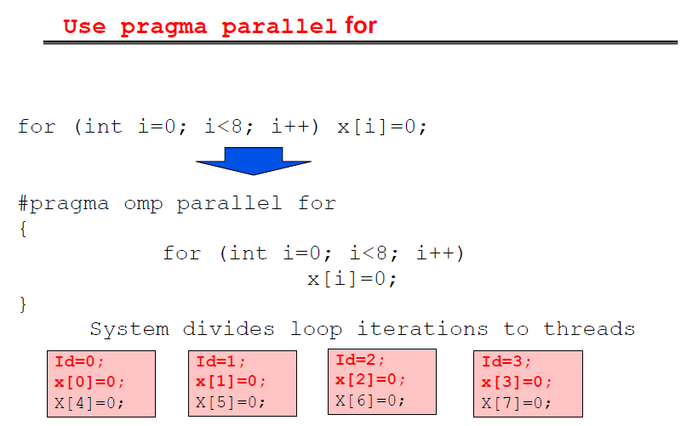

Slide 42
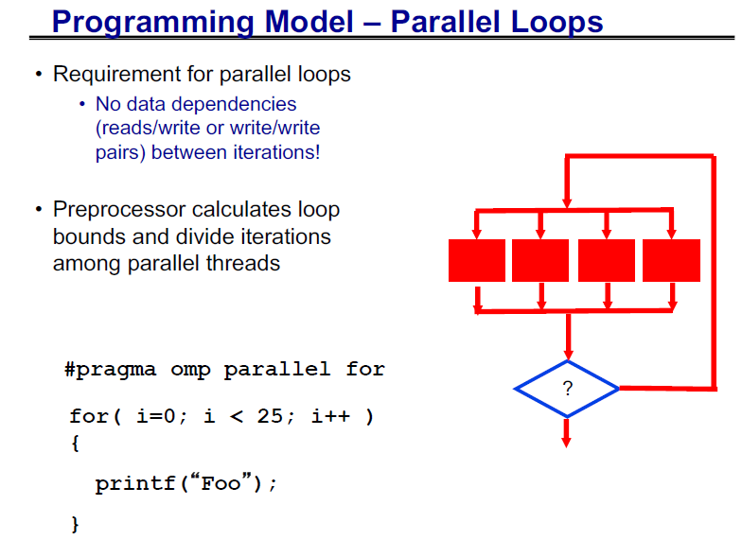

Slide 43
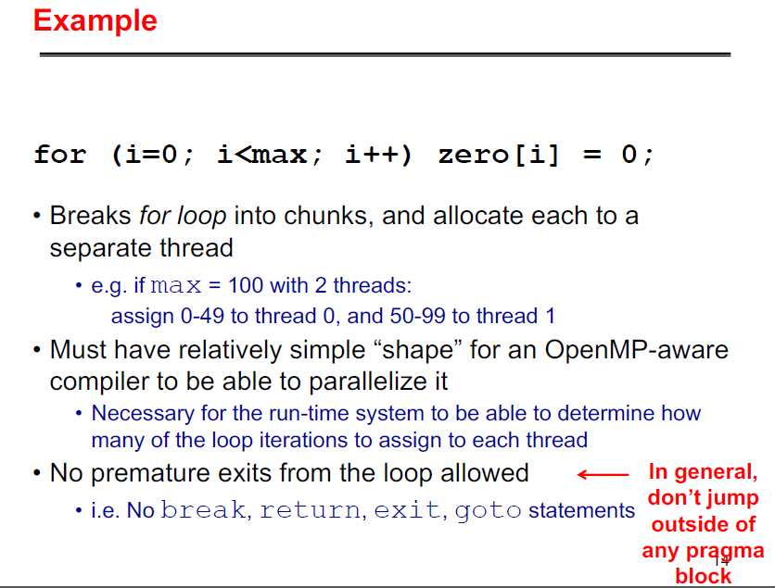

Slide 44
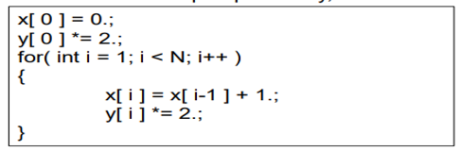
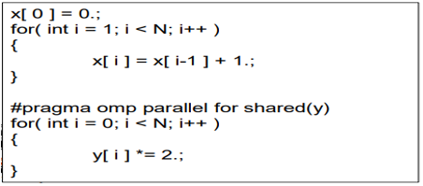
OpenMP: parallel loops

Slide 45
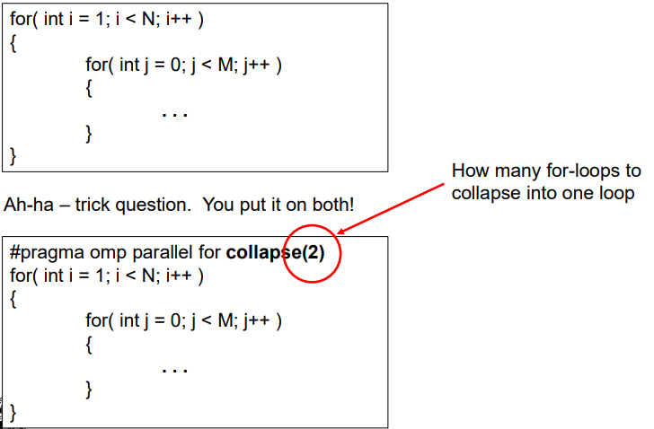
OpenMP: parallel loops

Slide 46
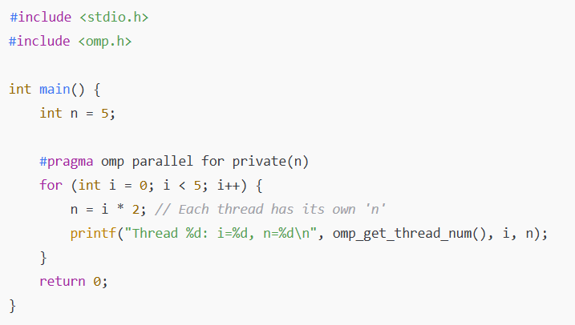

Slide 47
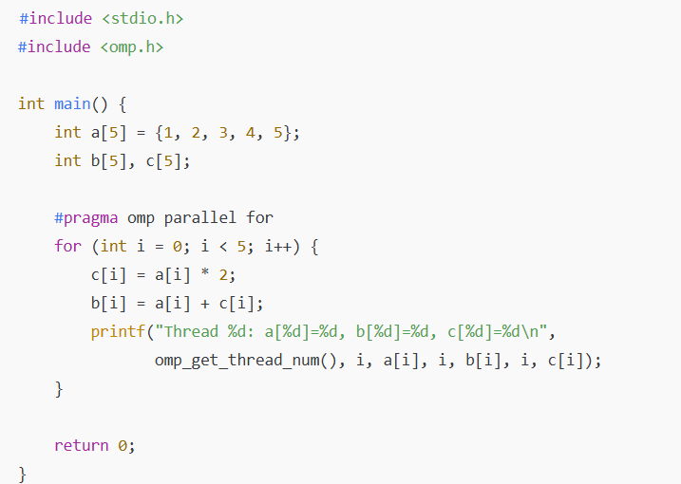

Slide 48
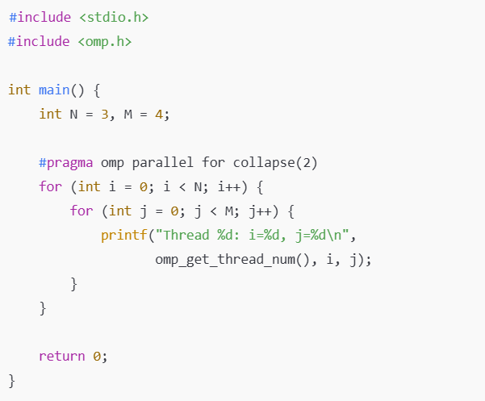

Slide 49
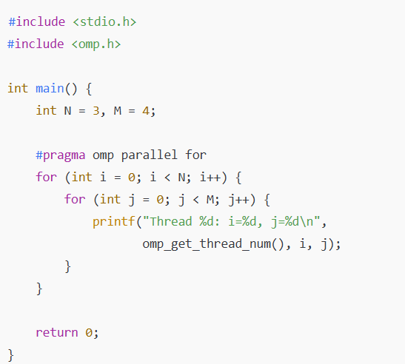

Slide 50
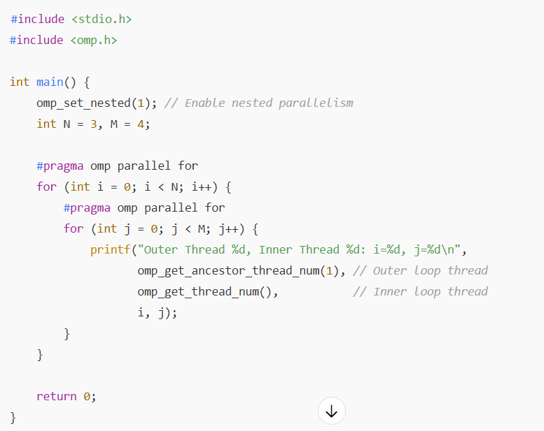

Slide 51
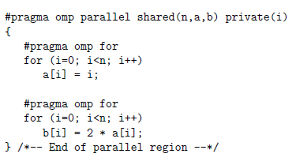
The Sections Construct
The sections construct is the easiest way to get different threads to carry out different kinds of work, since it permits us to specify several different code regions, each of which will be executed by one of the threads.
Two work-sharing loops in one parallel region
No guarantee that the distribution of iterations to threads is identical for both loops but the implied barrier ensures that results are available when needed.

Slide 52
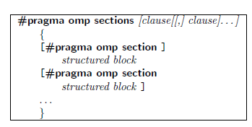
Each section must be a structured block of code that is independent of the other sections.
At run time, the specified code blocks are executed by the threads in the team. Each thread executes one code block at a time, and each code block will be executed exactly once.
If there are fewer threads than code blocks, some or all of the threads execute multiple code blocks.
If there are fewer code blocks than threads, the remaining threads will be idle.
The assignment of code blocks to threads is implementation-dependent.
Commonly used to execute function or subroutine calls in parallel.

Slide 53
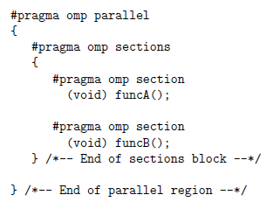
Example of parallel sections
If two or more threads are available, one thread invokes funcA() and another thread calls funcB(). Any other threads are idle.
This code fragment contains one sections construct, comprising two sections.
This limits the parallelism to two threads.
If two or more threads are available, function calls funcA and funcB are executed in parallel.
If only one thread is available, both calls to funcA and funcB are executed, but in sequential order.
One cannot make any assumption on the specific order in which section blocks are executed.
Even if these calls are executed sequentially, because the directive is not in an active parallel region, funcB may be called before funcA.

Slide 54
Load-balancing problem
Depending on the type of work performed in the various code blocks and the number of threads used, this construct might lead to a load-balancing problem.
This occurs when threads have different amounts of work to do and thus take different amounts of time to complete.
A result of load imbalance is that some threads may wait a long time at the next barrier in the program, which means that the hardware resources are not being efficiently exploited.
It may sometimes be possible to eliminate the barrier at the end of the construct but that does not overcome the fundamental problem of a load imbalance within the sections construct.

Slide 55
The Single Construct
The single construct is associated with the structured block of code immediately following it and specifies that this block should be executed by one thread only.
It does not state which thread should execute the code block; indeed, the thread chosen could vary from one run to another.
This construct should be used when we do not care which thread executes this part of the application, as long as the work gets done by exactly one thread.
The other threads wait at a barrier until the thread executing the single code block has completed.
Syntax:
#pragma omp single [clause[[,] clause]. . . ] structured block
Only one thread executes the structured block

Slide 56
Example of the single construct
Only one thread initializes the shared variable a. This variable is then used to initialize vector b in the parallelized for-loop
#pragma omp parallel shared(a,b) private(i)
{
#pragma omp single
{
a = 10;
printf("Single construct executed by thread %d\n",
omp_get_thread_num());
}
/* A barrier is automatically inserted here */
#pragma omp for
for (i=0; i<n; i++)
b[i] = a;
} /*-- End of parallel region --*/
printf("After the parallel region:\n");
for (i=0; i<n; i++)
printf("b[%d] = %d\n",i,b[i]);

Slide 57
A barrier is essential before the #pragma omp for loop. Without such a barrier, some threads would begin to assign values to elements of b before a has been assigned a value
Every thread would write the same value of 10 to the same variable a. However, this approach raises a hardware issue.
Depending on the data type, the processor details, and the compiler behavior, the write to memory might be translated into a sequence of store instructions, each store writing a subset of the variable.
Example: A variable 8 bytes long might be written to memory through 2 store instructions of 4 bytes each
Multiple threads could do this at the same time, resulting in an arbitrary combination of bytes in memory.
This issue is also related to the memory consistency model.
Moreover, multiple stores to the same memory address are bad for performance

Slide 58
Combined Parallel Work-Sharing Constructs
They are shortcuts that can be used when a parallel region comprises precisely one work-sharing construct, that is, the work sharing region includes all the code in the parallel region.
The combined parallel work-sharing constructs allow certain clauses that are supported by both the parallel construct and the workshare construct.
#pragma omp parallel
{
#pragma omp for
for (.....)
}
A single work-sharing loop in a parallel region – For cases like this OpenMP provides a shortcut.
#pragma omp parallel for
for (.....)

Slide 59
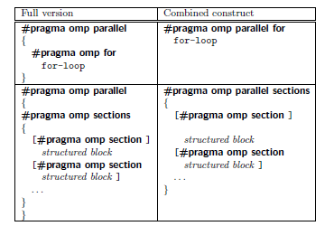
Syntax of the combined constructs in C/C++
The combined constructs may have a performance advantage over the more general parallel region with just one work-sharing construct embedded.
The main advantage of using these combined constructs is readability.
When the combined construct is used, a compiler knows what to expect and may be able to generate slightly more efficient code.

Slide 60
Clauses to Control Parallel and Work-Sharing Constructs
Shared Clause :
The shared clause is used to specify which data will be shared among the threads executing the region it is associated with.
Simply stated, there is one unique instance of these variables, and each thread can freely read or modify the values.
The syntax for this clause is shared(list) . All items in the list are data objects that will be shared among the threads in the team.
Here, vector a is declared to be shared. This implies that all threads are able to read and write elements of a.
Within the parallel loop, each thread will access the pre-existing values of those elements a[i] of a that it is responsible for updating and will compute their new values.
After the parallel region is finished, all the new values for elements of a will be in main memory, where the master thread can access them.
#pragma omp parallel for shared(a)
for (i=0; i<n; i++)
{
a[i] += i;
} /*-- End of parallel for --*/

Slide 61
Multiple threads might attempt to simultaneously update the same memory location or that one thread might try to read from a location that another thread is updating.
Special care has to be taken to ensure that neither of these situations occurs and that accesses to shared data are ordered as required by the algorithm.

Slide 62
Private Clause
Since the loop iterations are distributed over the threads in the team, each thread must be given a unique and local copy of the loop variable i so that it can safely modify the value.
Otherwise, a change made to i by one thread would affect the value of i in another thread’s memory, thereby making it impossible for the thread to keep track of its own set of iterations
private clause is used when data objects in a parallel region or work-sharing construct require which threads should be given their own copies
The syntax is private(list )
Each variable in the list is replicated so that each thread in the team of threads has exclusive access to a local copy of this variable.
Changes made to the data by one thread are not visible to other threads.

Slide 63
If variable a had been specified in a shared clause, multiple threads would attempt to update the same variable with different values in an uncontrolled manner.
The final value would thus depend on which thread happened to last update a. (This bug is a data race condition.) Therefore, the usage of a requires us to specify it to be a private variable, ensuring that each thread has its own copy.
#pragma omp parallel for private(i,a)
for (i=0; i<n; i++)
{
a = i+1;
printf("Thread %d has a value of a = %d for i = %d\n",
omp_get_thread_num(),a,i);
} /*-- End of parallel for --*/
Thread 0 has a value of a = 1 for i = 0
Thread 0 has a value of a = 2 for i = 1
Thread 2 has a value of a = 5 for i = 4
Thread 1 has a value of a = 3 for i = 2
Thread 1 has a value of a = 4 for i = 3

Slide 64
Lastprivate Clause
It ensures that the last value of a data object listed is accessible after the corresponding construct has completed execution.
In a parallel program, we must explain what “last” means.
In the case of its use with a work-shared loop, the object will have the value from the iteration of the loop that would be last in a sequential execution.
If the lastprivate clause is used on a sections construct, the object gets assigned the value that it has at the end of the lexically last sections construct.
The syntax is lastprivate(list ).

Slide 65
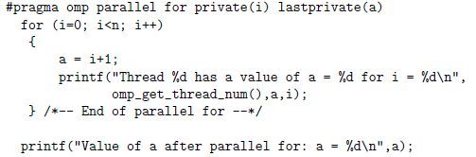
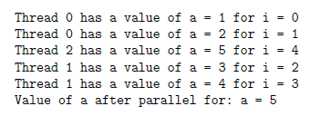
Variable a now has the lastprivate data-sharing attribute
There is a print statement after the parallel region so that we can check on the value a has at that point.
According to the definition of “last,” the value of variable a after the parallel region, should correspond to that computed when i = n-1
Output: Variable n is set to 5, and three threads are used. The last value of variable a corresponds to the value for i = 4
Output:

Slide 66
Firstprivate Clause
Variables that are declared to be “firstprivate” are private variables, but they are pre-initialized with the value of the variable with the same name before the construct.
The initialization is carried out by the initial thread prior to the execution of the construct.
The firstprivate clause is supported on the parallel construct, plus the work-sharing loop, sections, and single constructs.
The syntax is firstprivate(list ).

Slide 67
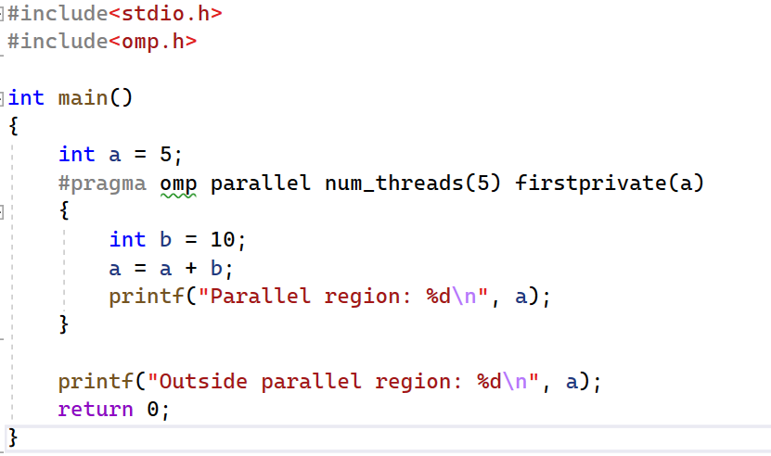
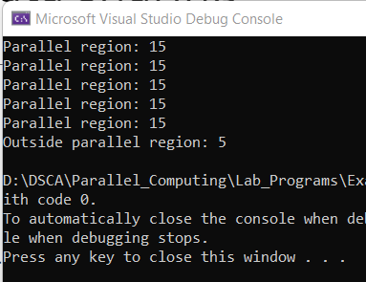

Slide 68
Default Clause
The default clause is used to give variables a default data-sharing attribute
Example:
default(shared) assigns the shared attribute to all variables referenced in the construct.
The default(private) clause, which is not supported in C/C++, makes all variables private by default. It is applicable to the parallel construct only.
This clause is used to define the data-sharing attribute of the majority of the variables in a parallel region. Only the exceptions need to be explicitly listed:
#pragma omp for default(shared) private(a,b,c), declares all variables to be shared, with the exception of a, b, and c.

Slide 69
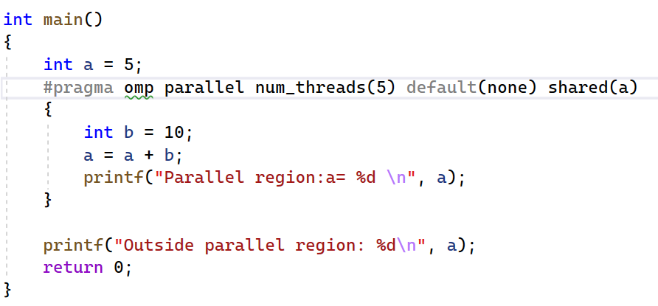
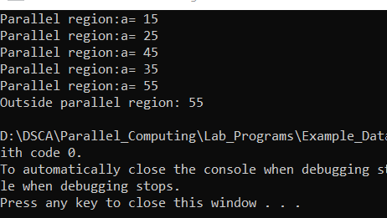
If default(none) is specified, the programmer is forced to specify a data-sharing attribute for each variable in the construct.
Although variables with a predetermined data-sharing attribute need not be listed in one of the clauses
It is recommended that the attribute be explicitly specified for all variables in the construct.

Slide 70

Nowait Clause
The nowait clause allows the programmer to fine-tune a program’s performance.
In the work-sharing constructs, there is an implicit barrier at the end of them. This clause overrides that feature of OpenMP;
That is, if it is added to a construct, the barrier at the end of the associated construct will be suppressed.
When threads reach the end of the construct, they will immediately proceed to perform other work.
However, the barrier at the end of a parallel region cannot be suppressed.
When a thread is finished with the work associated with the parallelized for loop, it continues and no longer waits for the other threads to finish as well.
The clause ensures that there is no barrier at the end of the loop.

Slide 71
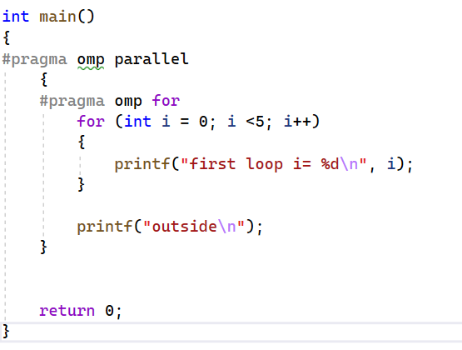
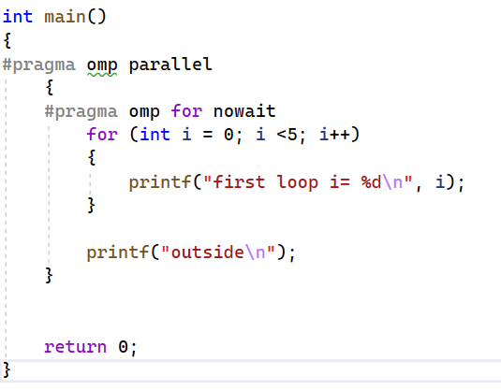
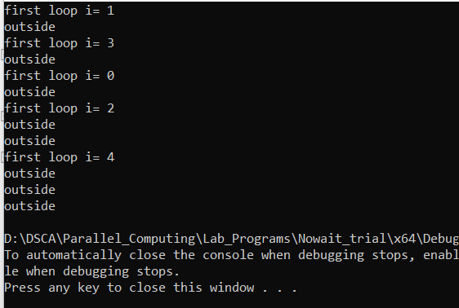
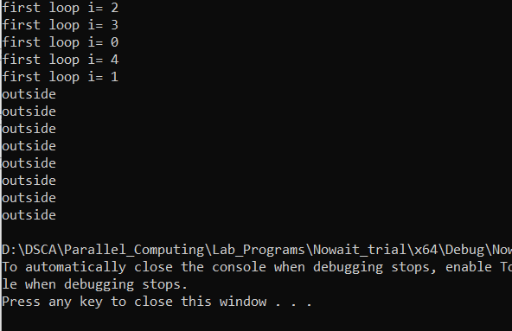

Slide 72
Schedule Clause
The schedule clause is supported on the loop construct only.
It is used to control the manner in which loop iterations are distributed over the threads, which can have a major impact on the performance of a program.
The syntax is schedule(kind[,chunk_size] )
The schedule clause specifies how the iterations of the loop are assigned to the threads in the team.
The granularity of this workload distribution is a chunk, a contiguous, nonempty subset of the iteration space.
The chunk_size parameter need not be a constant; any loop invariant integer expression with a positive value is allowed

Slide 73
Kinds of Schedule
Static :
Iterations are divided into chunks of size chunk size.
The chunks are assigned to the threads statically in a round-robin manner, in the order of the thread number.
The last chunk to be assigned may have a smaller number of iterations.
When no chunk size is specified, the iteration space is divided into chunks that are approximately equal in size.
Each thread is assigned at most one chunk.
Dynamic:
The iterations are assigned to threads as the threads request them.
The thread executes the chunk of iterations (controlled through the chunk size parameter), then requests another chunk until there are no more chunks to work on.
The last chunk may have fewer iterations than chunk size.
When no chunk size is specified, it defaults to 1.

Slide 74
Guided:
The iterations are assigned to threads as the threads request them.
The thread executes the chunk of iterations (controlled through the chunk size parameter), then requests another chunk until there are no more chunks to work on.
For a chunk size of 1, the size of each chunk is proportional to the number of unassigned iterations, divided by the number of threads, decreasing to 1.
For a chunk size of “k” (k > 1), the size of each chunk is determined in the same way, with the restriction that the chunks do not contain fewer than k iterations
When no chunk size is specified, it defaults to 1.
Runtime:
If this schedule is selected, the decision regarding scheduling kind is made at run time.
The schedule and (optional) chunk size are set through the OMP_SCHEDULE environment variable.

Slide 75
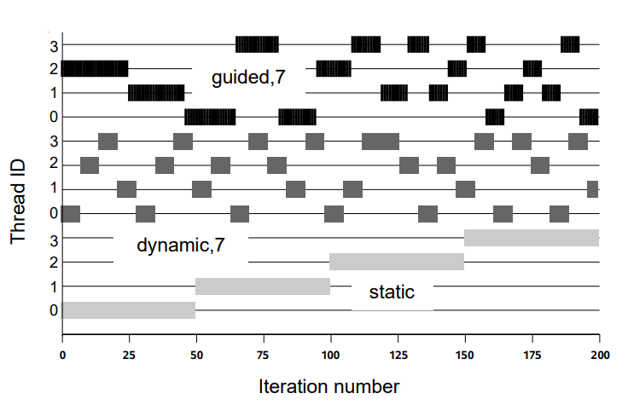
OpenMP: Schedule Clause

Slide 76
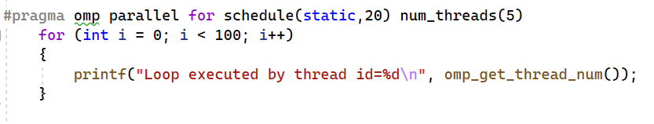
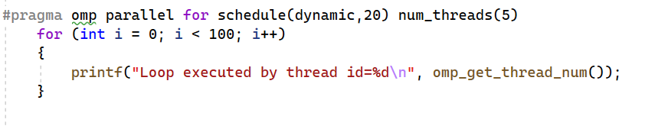
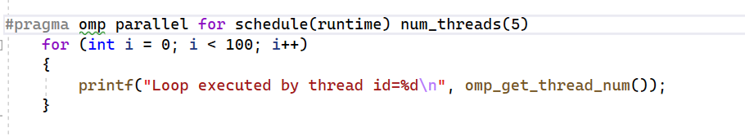
OpenMP: Schedule Clause

Slide 77
All three workload distribution algorithms support an optional chunk size parameter.
For example, a chunk size bigger than 1 on the static schedule may give rise to a round-robin allocation scheme in which each thread executes the iterations in a sequence of chunks whose size is given by chunk size.
It is not always easy to select the appropriate schedule and value for chunk size up front.
The choice may depend (among other things) not only on the code in the loop but also on the specific problem size and the number of threads used.
Therefore, the runtime clause is convenient.
Instead of making a compile time decision, the OpenMP OMP_SCHEDULE environment variable can be used to choose the schedule and (optional) chunk size at run time

Slide 78
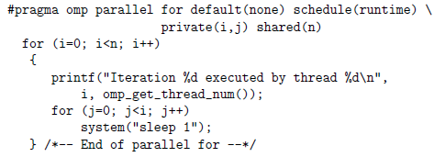
Example for schedule clause
The outer loop has been parallelized with the loop construct.
The workload in the inner loop depends on the value of the outer loop iteration variable i.
Therefore, the workload is not balanced, and the static schedule is probably not the best choice.

Slide 79
OpenMP Synchronization Constructs
Help to organize accesses to shared data by multiple threads.
An algorithm may require us to orchestrate the actions of multiple threads to ensure that updates to a shared variable occur in a certain order, or it may simply need to ensure that two threads do not simultaneously attempt to write a shared object.
These features can be used when the implicit barrier provided with work-sharing constructs does not suffice to specify the required interactions or would be inefficient.
Together with the work-sharing constructs, they constitute a powerful set of features that suffice to parallelize a large number of applications.
Types of Constructs:
Barrier Construct
Ordered Construct
Critical Construct
Atomic Construct
Locks
Master Construct

Slide 80
Barrier Construct
A barrier is a point in the execution of a program where threads wait for each other:
no thread in the team of threads it applies to, may proceed beyond a barrier until all threads in the team have reached that point.
Compiler automatically inserts a barrier at the end of the construct, so that all threads wait there until all of the work associated with the construct has been completed.
Thus, it is often not necessary for the programmer to explicitly add a barrier to a code.
Two important restrictions apply to the barrier construct:
Each barrier must be encountered by all threads in a team, or by none at all.
The sequence of work-sharing regions and barrier regions encountered must be the same for every thread in the team.
#pragma omp barrier

Slide 81
Without these restrictions, one could write programs where some threads wait forever (or until somebody kills the process) for other threads to reach a barrier.
C/C++ imposes an additional restriction regarding the placement of a barrier construct within the application
The barrier construct may only be placed in the program at a position where ignoring or deleting it would result in a program with correct syntax.
The most common use for a barrier is to avoid a data race condition
Inserting a barrier between the writes to and reads from a shared variable guarantees that the accesses are appropriately ordered

Slide 82
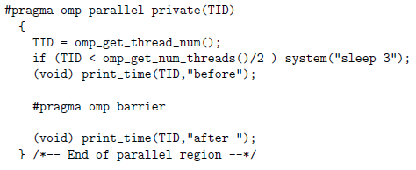
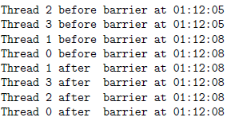
To ensure that some threads in the team executing the parallel region take longer than others to reach the barrier, we get half the threads to execute the sleep 3 command, causing them to idle for three seconds.
We then get each thread to print out its the thread number (stored in variable TID), a comment string, and the time of day in the format hh:mm:ss.
The barrier is then reached.
After the barrier, each thread will resume execution and again print out this information.
Four threads are used. Note that threads 2 and 3 wait for three seconds in the barrier.

Slide 83

Ordered Construct
Another synchronization construct, the ordered construct, allows one to execute a structured block within a parallel loop in sequential order.
This is used to enforce an ordering on the printing of data computed by different threads.
It may also be used to help determine whether there are any data races in the associated code.
The syntax of the ordered construct
An ordered construct ensures that the code within the associated structured block is executed in sequential order.
The code outside this block runs in parallel. When the thread executing the first iteration of the loop encounters the construct, it enters the region without waiting.
When a thread executing any subsequent iteration encounters the construct, it waits until each of the previous iterations in the sequence has completed execution of the region

Slide 84
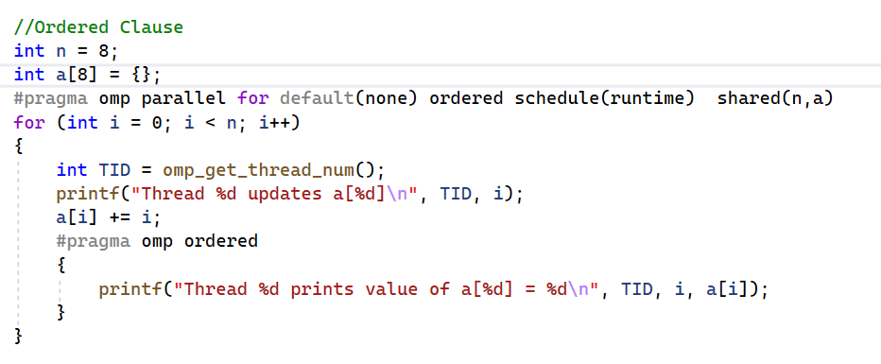
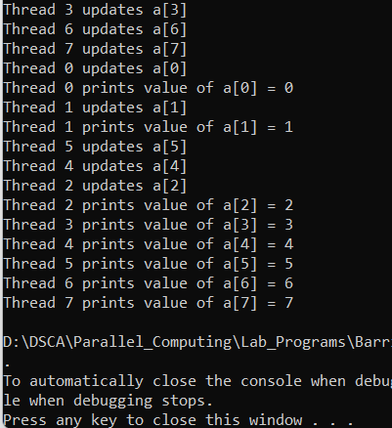
Synchronization Constructs: Ordered

Slide 85

Critical Construct
The critical construct provides a means to ensure that multiple threads do not attempt to update the same shared data simultaneously. The associated code is referred to as a critical region, or a critical section.
An optional name can be given to a critical construct. In contrast to the rules governing other language features, this name is global and therefore should be unique
When a thread encounters a critical construct, it waits until no other thread is executing a critical region with the same name.
In other words, there is never a risk that multiple threads will execute the code contained in the same critical region at the same time.

Slide 86
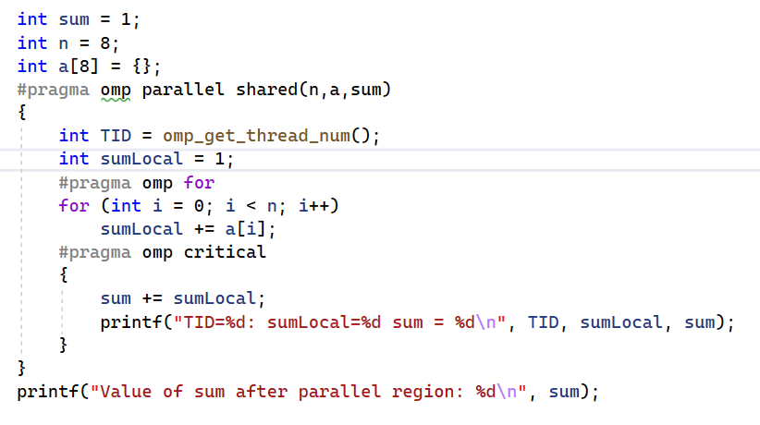
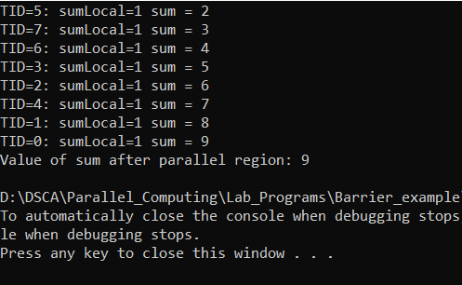
Synchronization Constructs: Critical

Slide 87

Atomic Construct
The atomic construct enables efficient updating of shared variables by multiple threads on hardware platforms which support atomic operations.
The reason it is applied to just one assignment statement is that it protects updates to an individual memory location, the one on the left-hand side of the assignment.
If a thread is atomically updating a value, then no other thread may do so simultaneously.
This restriction applies to all threads that execute a program, not just the threads in the same team.
Syntax is:
The atomic construct may only be used together with an expression statement in C/C++. The supported operations are: +, *, -, /, &, ^, |, <<, >>

Slide 88
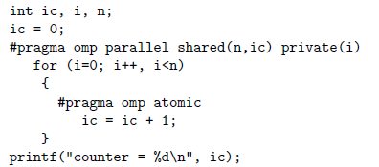
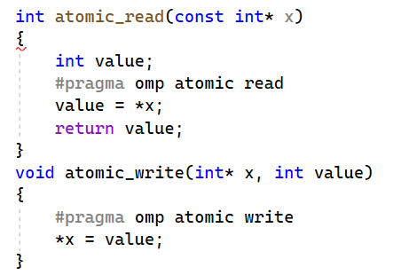
The atomic construct ensures that no updates are lost when multiple threads are updating a counter value.

Slide 89
Locks
A set of low-level, general-purpose runtime library routines, similar in function to the use of semaphores. These routines provide greater flexibility for synchronization than does the use of critical sections or atomic constructs.
A thread lock is an object that can be held by at most one thread at a time
An OpenMP lock can be in one of the following states:
Uninitialized; Unlocked; or Locked
If a lock is in the unlocked state, a thread can set the lock, which changes its state to locked
The thread that sets the lock is then said to own the lock
A thread that owns a lock can unset that lock, returning it to the unlocked state
Syntax is : void omp_func_lock (omp lock t *lck)

Slide 90
There are two types of locks:
Simple locks,
which may not be locked if already in a locked state
Simple lock variables are declared with the special type omp_lock_t in C/C++
Nestable locks,
Which may be locked multiple times by the same thread
Nestable lock variables are declared with the special type omp_nest_lock_t in C/C++

Slide 91
The general procedure to use locks is as follows:
Define the lock variables using omp_lock_t
Initialize the lock via a call to omp_init_lock()
Set the lock using omp_set_lock() or omp_test_lock(). The latter checks whether the lock is actually available before attempting to set it. It is useful to achieve asynchronous thread execution
Unset a lock after the work is done via a call to omp_unset_lock()
Remove the lock association via a call to omp_destroy_lock()

Slide 92
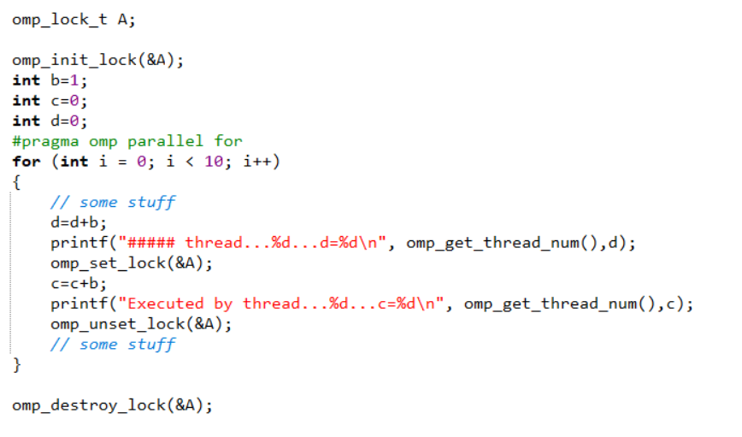

Synchronization Constructs: Locks

Slide 93
Master Construct
The master construct defines a block of code that is guaranteed to be executed by the master thread only
It is thus similar to the single construct
The master construct is technically not a work-sharing construct, however, and it does not have an implied barrier on entry or exit
If the master construct is used to initialize data, for example, care needs to be taken that this initialization is completed before the other threads in the team use the data
Syntax is: #pragma omp master
structured block

Slide 94


Synchronization Constructs: Master

Slide 95
OpenMP: Other Clauses
If Clause
The if clause is supported on the parallel construct only, where it is used to specify conditional execution
Since some overheads are inevitably incurred with the creation and termination of a parallel region, it is sometimes necessary to test whether there is enough work in the region to warrant its parallelization
if(scalar-logical-expression )
If the logical expression evaluates to true, which means it is of type integer and has a non-zero value in C/C++, the parallel region will be executed by a team of threads
If it evaluates to false, the region is executed by a single thread only

Slide 96




OpenMP: If Clause

Slide 97
Num_threads Clause
The num threads clause is supported on the parallel construct only
Can be used to specify how many threads should be in the team executing the parallel region
Has higher priority over omp_set_num_threads(4)

Slide 98
Reduction Clause
OpenMP provides the reduction clause for specifying some forms of recurrence calculations
They can be performed in parallel without code modification
The programmer must identify the operations and the variables that will hold the result values
reduction(operator :list )
The order in which thread-specific values are combined is unspecified
floating-point data are concerned, there may be numerical differences between the results of a sequential and parallel run

Slide 99





Slide 100

Aggregate types (including arrays), pointer types, and reference types are not supported.
A reduction variable must not be const-qualified.
The operator specified on the clause can not be overloaded with respect to the variables that appear in the clause

Slide 101
Copyin Clause
Allows us to copy the value of the master thread’s threadprivate variable(s) to the corresponding threadprivate variables of the other threads
Threadprivate:
Static variables are generally shared by default
We can change this by using threadprivate clause (We will discuss this later)
The initial values of private variables are undefined
The copy is carried out after the team of threads is formed and prior to the start of execution of the parallel region, so that it enables a straightforward initialization of this kind of data object.

Slide 102
Copyprivate Clause
The copyprivate clause is supported on the single directive only
It provides a mechanism for broadcasting the value of a private variable from one thread to the other threads in the team
Uses: one thread read or initialize private data that is subsequently used by the other threads as well
After the single construct has ended, but before the threads have left the associated barrier, the values of variables specified in the associated list are copied to the other threads
Since the barrier is essential in this case, the standard prohibits use of this clause in combination with the nowait clause

Slide 103



Slide 104



Slide 105
Nested parallelism
If a thread in a team executing a parallel region encounters another parallel construct, it creates a new team and becomes the master of that new team
This is generally referred to in OpenMP as “nested parallelism”
If nested parallelism is not supported
parallel constructs that are nested within other parallel constructs will be ignored
parallel region serialized (executed by a single thread only)
Frequent starting and stopping of parallel regions may introduce a non-trivial performance penalty
What will happen if we call omp_get_thread_num() function from the nested region?
It returns the thread id starting from 0 to one less than the number of threads in the current thread team
Thread numbers are no longer unique

Slide 106


Nested parallelism

Slide 107


Nested parallelism

Slide 108
OpenMP: Flush Directive
OpenMP memory model distinguishes between shared data and private data:
Which is accessible and visible to all threads (shared data)
Which is local to an individual thread (private data)
If a thread updates shared data, the new values will first be saved in a register and then stored back to the local cache
Other threads doesn’t have access to these memories immediately
Cache-Coherent machines: Broadcasts these shared variables to other threads
The OpenMP standard specifies that all modifications are written back to main memory
Modifications are thus available to all threads, at synchronization points in the program

Slide 109

OpenMP: Flush Directive
Between these synchronization points, threads are permitted to have new values for shared variables stored in their local memory rather than in the global shared memory
This approach is called as relaxed consistency model
Sometimes updated values of shared values must become visible to other threads in-between synchronization points
The OpenMP API provides the flush directive to make this possible
The purpose of the flush directive is to make a thread’s temporary view of shared data consistent with the values in memory

Slide 110
OpenMP: Flush Directive
The flush operation applies to all variables specified in the list
If no list is provided, it applies to all thread-visible shared data
If the flush operation is invoked by a thread that has updated the variables, their new values will be flushed to memory and therefore be accessible to all other threads
If the construct is invoked by a thread that has not updated a value, it will ensure that any local copies of the data are replaced by the latest value from main memory
This does not synchronize the actions of different threads: rather, it forces the executing thread to make its shared data values consistent with shared memory
Since the compiler reorders operations to enhance program performance, one cannot assume that the flush operation will remain exactly in the position, relative to other operations, in which it was placed by the programmer

Slide 111
OpenMP: Flush Directive
Implicit flush operations with no list occur at the following locations
All explicit and implicit barriers (e.g., at the end of a parallel region or worksharing construct)
Entry to and exit from critical regions
Entry to and exit from lock routines

Slide 112

OpenMP: Flush Directive

Slide 113

OpenMP: Threadprivate Directive
By default, global data is shared
Each thread gets a private or “local” copy of the specified global variables
By default, the threadprivate copies are not allocated or defined

Slide 114
OpenMP Code Structure
“Pragma”: stands for “pragmatic information
A pragma is a way to communicate the information to the compiler
The information is non-essential in the sense that the compiler may ignore the information and still produce correct object program.

Slide 115
OpenMP Core Syntax
#include “omp.h”
int main ()
{
int var1, var2, var3;
// Serial code . . .
// Beginning of parallel section.
// Fork a team of threads. Specify variable scoping
#pragma omp parallel private(var1, var2) shared(var3)
{
// Parallel section executed by all threads . . .
// All threads join master thread and disband
}
// Resume serial code . . .
}

Slide 116
Thread Creation: Parallel Region Example
#include <stdio.h>
#include "omp.h"
int main()
{
int nthreads, tid;
#pragma omp parallel num_threads(4) private(tid)
{
tid = omp_get_thread_num();
printf("Hello world from (%d)\n", tid);
if(tid == 0)
{
nthreads = omp_get_num_threads();
printf(“number of threads = %d\n”, nthreads);
}
} // all threads join master thread and terminates
}

Slide 117
Thread Creation: Parallel Region Example
#include <stdio.h>
#include "omp.h"
int main()
{
int nthreads, A[100] , tid;
// fork a group of threads with each thread having a private tid variable
omp_set_num_threads(4);
#pragma omp parallel private (tid)
{
tid = omp_get_thread_num();
foo(tid, A);
}
// all threads join master thread and terminates
}

Slide 118
OpenMP controlling number of threads
Asking how many cores this program has access to:
num = omp_get_num_procs( );
Setting the number of available threads to the exact number of cores available:
omp_set_num_threads( omp_get_num_procs( ) );
Asking how many OpenMP threads this program is using right now:
num = omp_get_num_threads( );
Asking which thread number this one is:
me = omp_get_thread_num( );

Slide 119
END

